Slide 1
Python from the Very Beginning - Installation
Joe Cursio (jcursio@ben.edu and jcursio@stuart.iit.edu )
DuPage Python Users Group
March 11, 2020 (Lisle, IL)

Slide 2

A Word from Our Sponsors
TBD

Slide 3
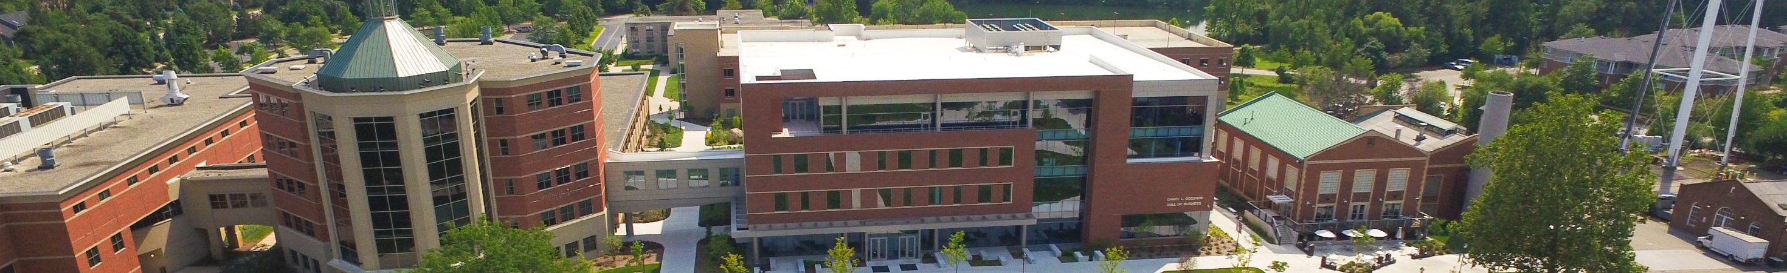
A Word from Our Sponsors
Benedictine University offers classes.
Talk to me
See www.ben.edu for more information

Slide 4
At Any Time, Feel Free To ___
Interrupt me and ask questions
Have me repeat something and/or slow down
Have someone see what’s on your laptop
Talk with other people
…

Slide 5
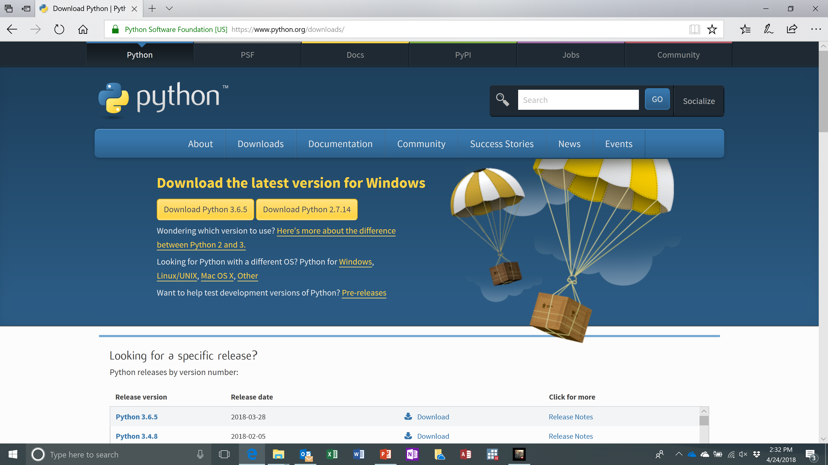
Where to Find the Software
I googled “python download” to find www.python.org/downloads/
The home page looks a little something like this.
My flash drive contains installation files for Windows, Apple, and Linux
I hope Apple and Linux are just as easy to install

Slide 6
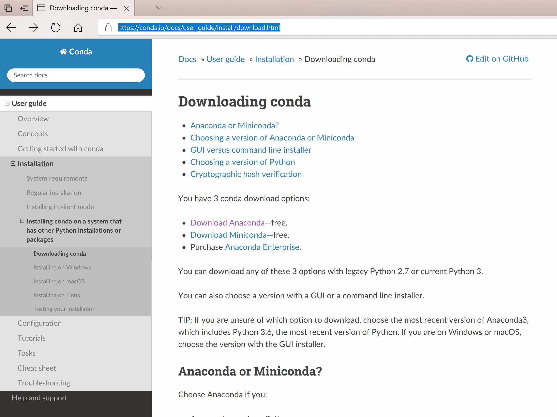
Where to Find the Software
I googled “Anaconda download” to find https://conda.io/docs/user-guide/install/download.html
Anaconda contains hundreds of libraries of additional functionality. I chose to include all that extra stuff
It takes a few minutes to install and setup. Grab some pizza.
Notes:
This is where we find the better user interface. It’s called “Spyder”
The company called Anaconda has other products that are really nice, but for now we want the better user interface

Slide 7
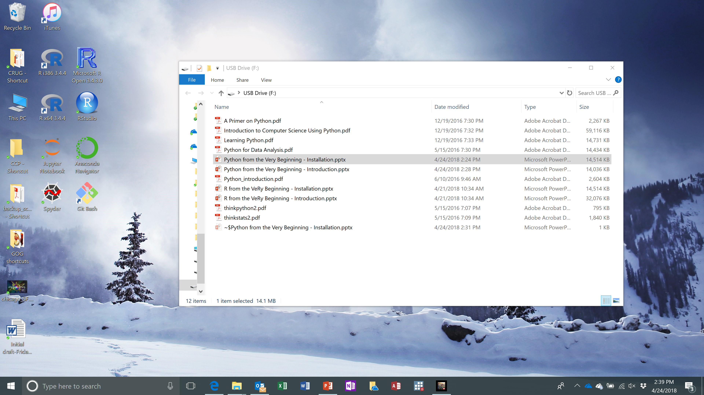
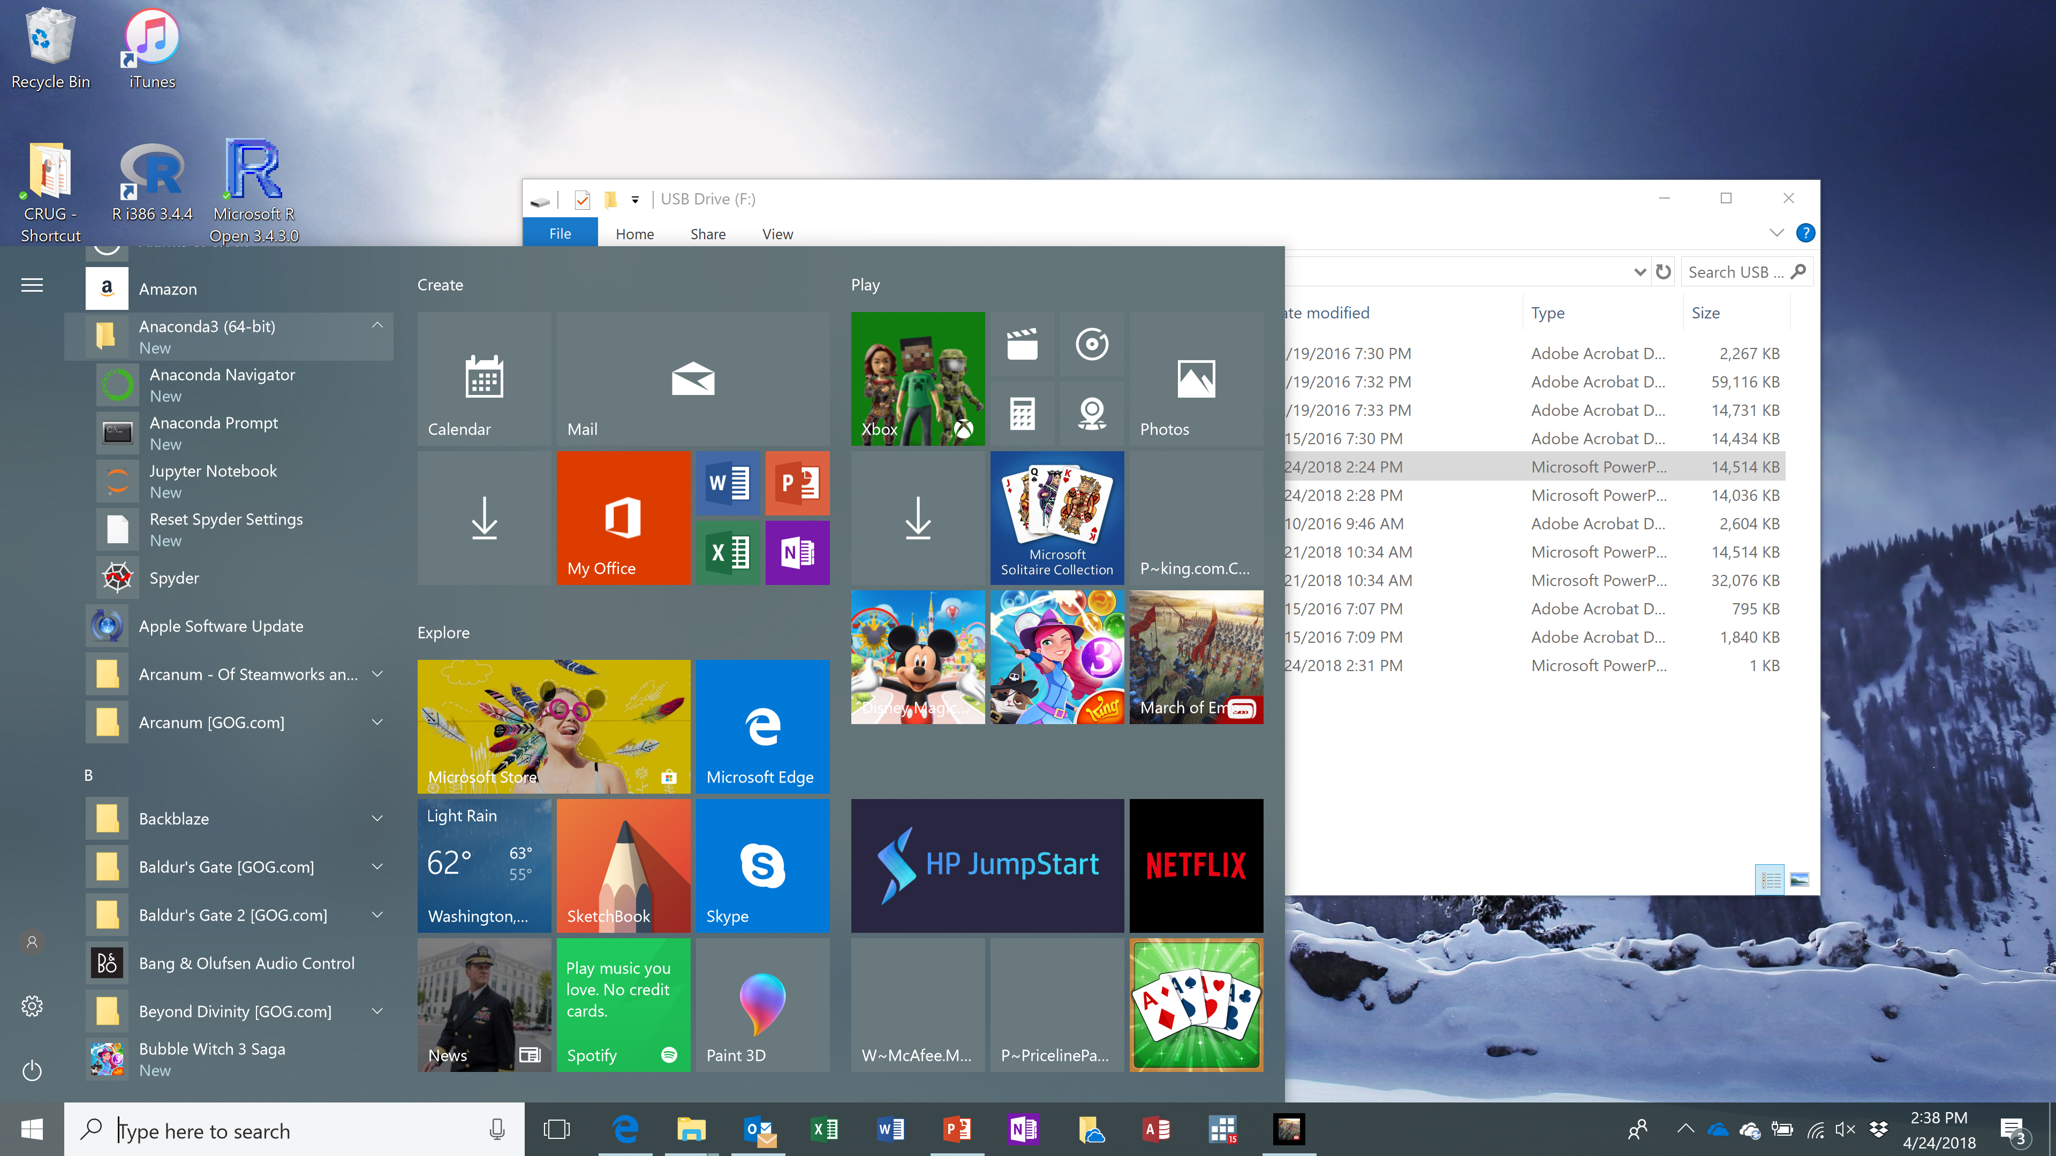
Starting Python in Windows
You can start via Windows > Start
I created shortcuts on the desktop
Sorry, I don’t know how this works in Apple and Linux. Hopefully, it works very much the same way
Notes:
For me, after the installation process was finished, I can start Spyder in two ways:
I have some shortcuts on my desktop
It is also in the Windows start menu
If you’re using Apple or Unix, starting the program will be a bit different for you. Sorry I cannot help you much.
I only use Windows.

